Slide 1
Natural Language Processing DTS305TC
Huakang Li
Huakang.li@xjtlu.edu.cn
School of AI and Advanced Computing
Notes:
English Title: Uppercase, Calibri size 60, XJTLU Navy
English Subtitle: Uppercase, Calibri size 36, XJTLU Navy

Slide 2
Brief Introduction to the Module
This advanced module introduces essential principles of Natural Language Processing (NLP), focusing on techniques, algorithms, and applications that enable computers to process and understand human language.
It forms a crucial part of the curriculum for students pursuing degrees in data science and related fields, building upon foundational knowledge.
The module is structured to provide both theoretical understanding and practical skills, with a blend of intensive teaching blocks, seminars, and computer labs.
Emphasis is placed on real-world problem-solving using NLP models and techniques, facilitated by hands-on group assignments and individual projects, aligning with an educational approach that prioritizes meaningful industry interaction and practical coursework over traditional exams.

Slide 3
Key Module Information
Module name: Natural Language Processing
Module code: DTS305TC
Credit value: 5
Semester in which the module is taught: Block 1 Semester 1
Pre-requisites needed for the module: DTS101TC
Programmes on which the module is shared: BEng Data Science and Big Data Technology with Contemporary Entrepreneurialism

Slide 4
Delivery Schedule
Lectures
Time (Week 1-5) | Teaching mode
Monday, D1, AM10:00-12:00 | Onsite TC-FG-2001
Wednesday, D2, AM10:00-12:00 | Onsite TC-FG-2001
Labs
Time (Week 1-5) | Teaching mode
Group1-Day1, Monday, PM13:00-15:00 | Onsite TC-D-3001 Ziyu
Group2-Day1, Monday, PM 15:00-17:00 | Onsite TC-D-3001 Bolin
Group3-Day1, Tuesday,PM 16:00-18:00 | Onsite TC-D-3001 Jingxuan
Group1-Day2, Wednesday, PM 16:00-18:00 | Onsite TC-D-3001 Ziyu
Group2-Day2, Thursday, AM 9:00-11:00 | Onsite TC-D-3001 Bolin
Group3-Day2, Thursday, AM 11:00-13:00 | Onsite TC-D-3001 Jingxuan
Seminars
Time (Week 6) | Teaching mode
Monday, AM10:00-12:00 | Onsite TC-FG-2001

Slide 5
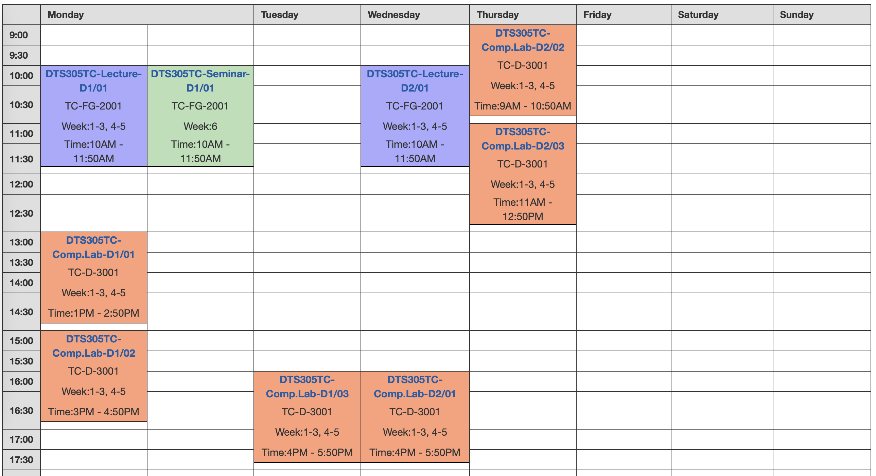
teaching plan

Slide 6
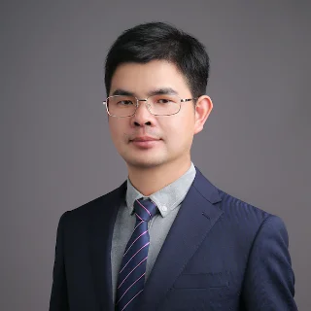
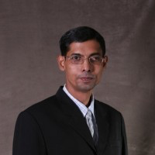
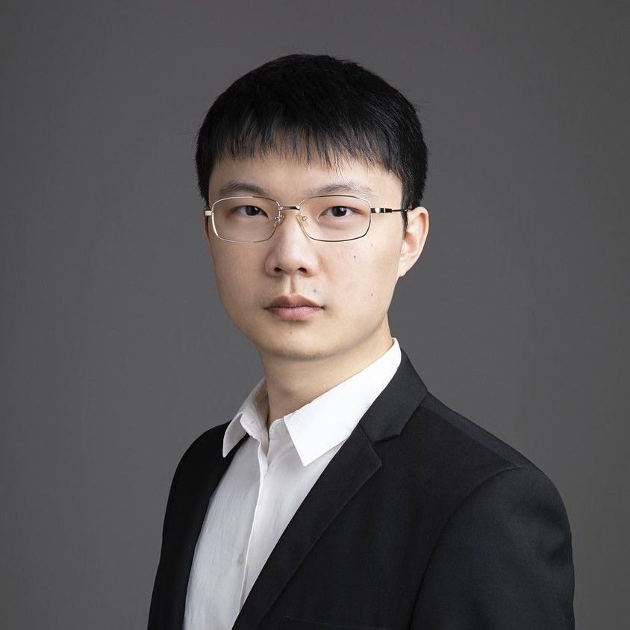
Module Leader & Co-teachers
Dr. Huakang Li
huakang.li@xjtlu.edu.cn
TC-D-5025
Monday 15:00 - 17:00, Wednesday 13:00 - 15:00
(by appointment)
Dr. Md Maruf Hasan
MdMaruf.Hasan@xjtlu.edu.cn
TC-D-5009,
Tuesday 1400-1600
(by appointment)
Dr. Qi Chen
Qi.Chen02@xjtlu.edu.cn
TC-D-5007
Tuesday 14:00 - 16:00
Thursday 14:00 - 16:00
(by appointment)

Slide 7
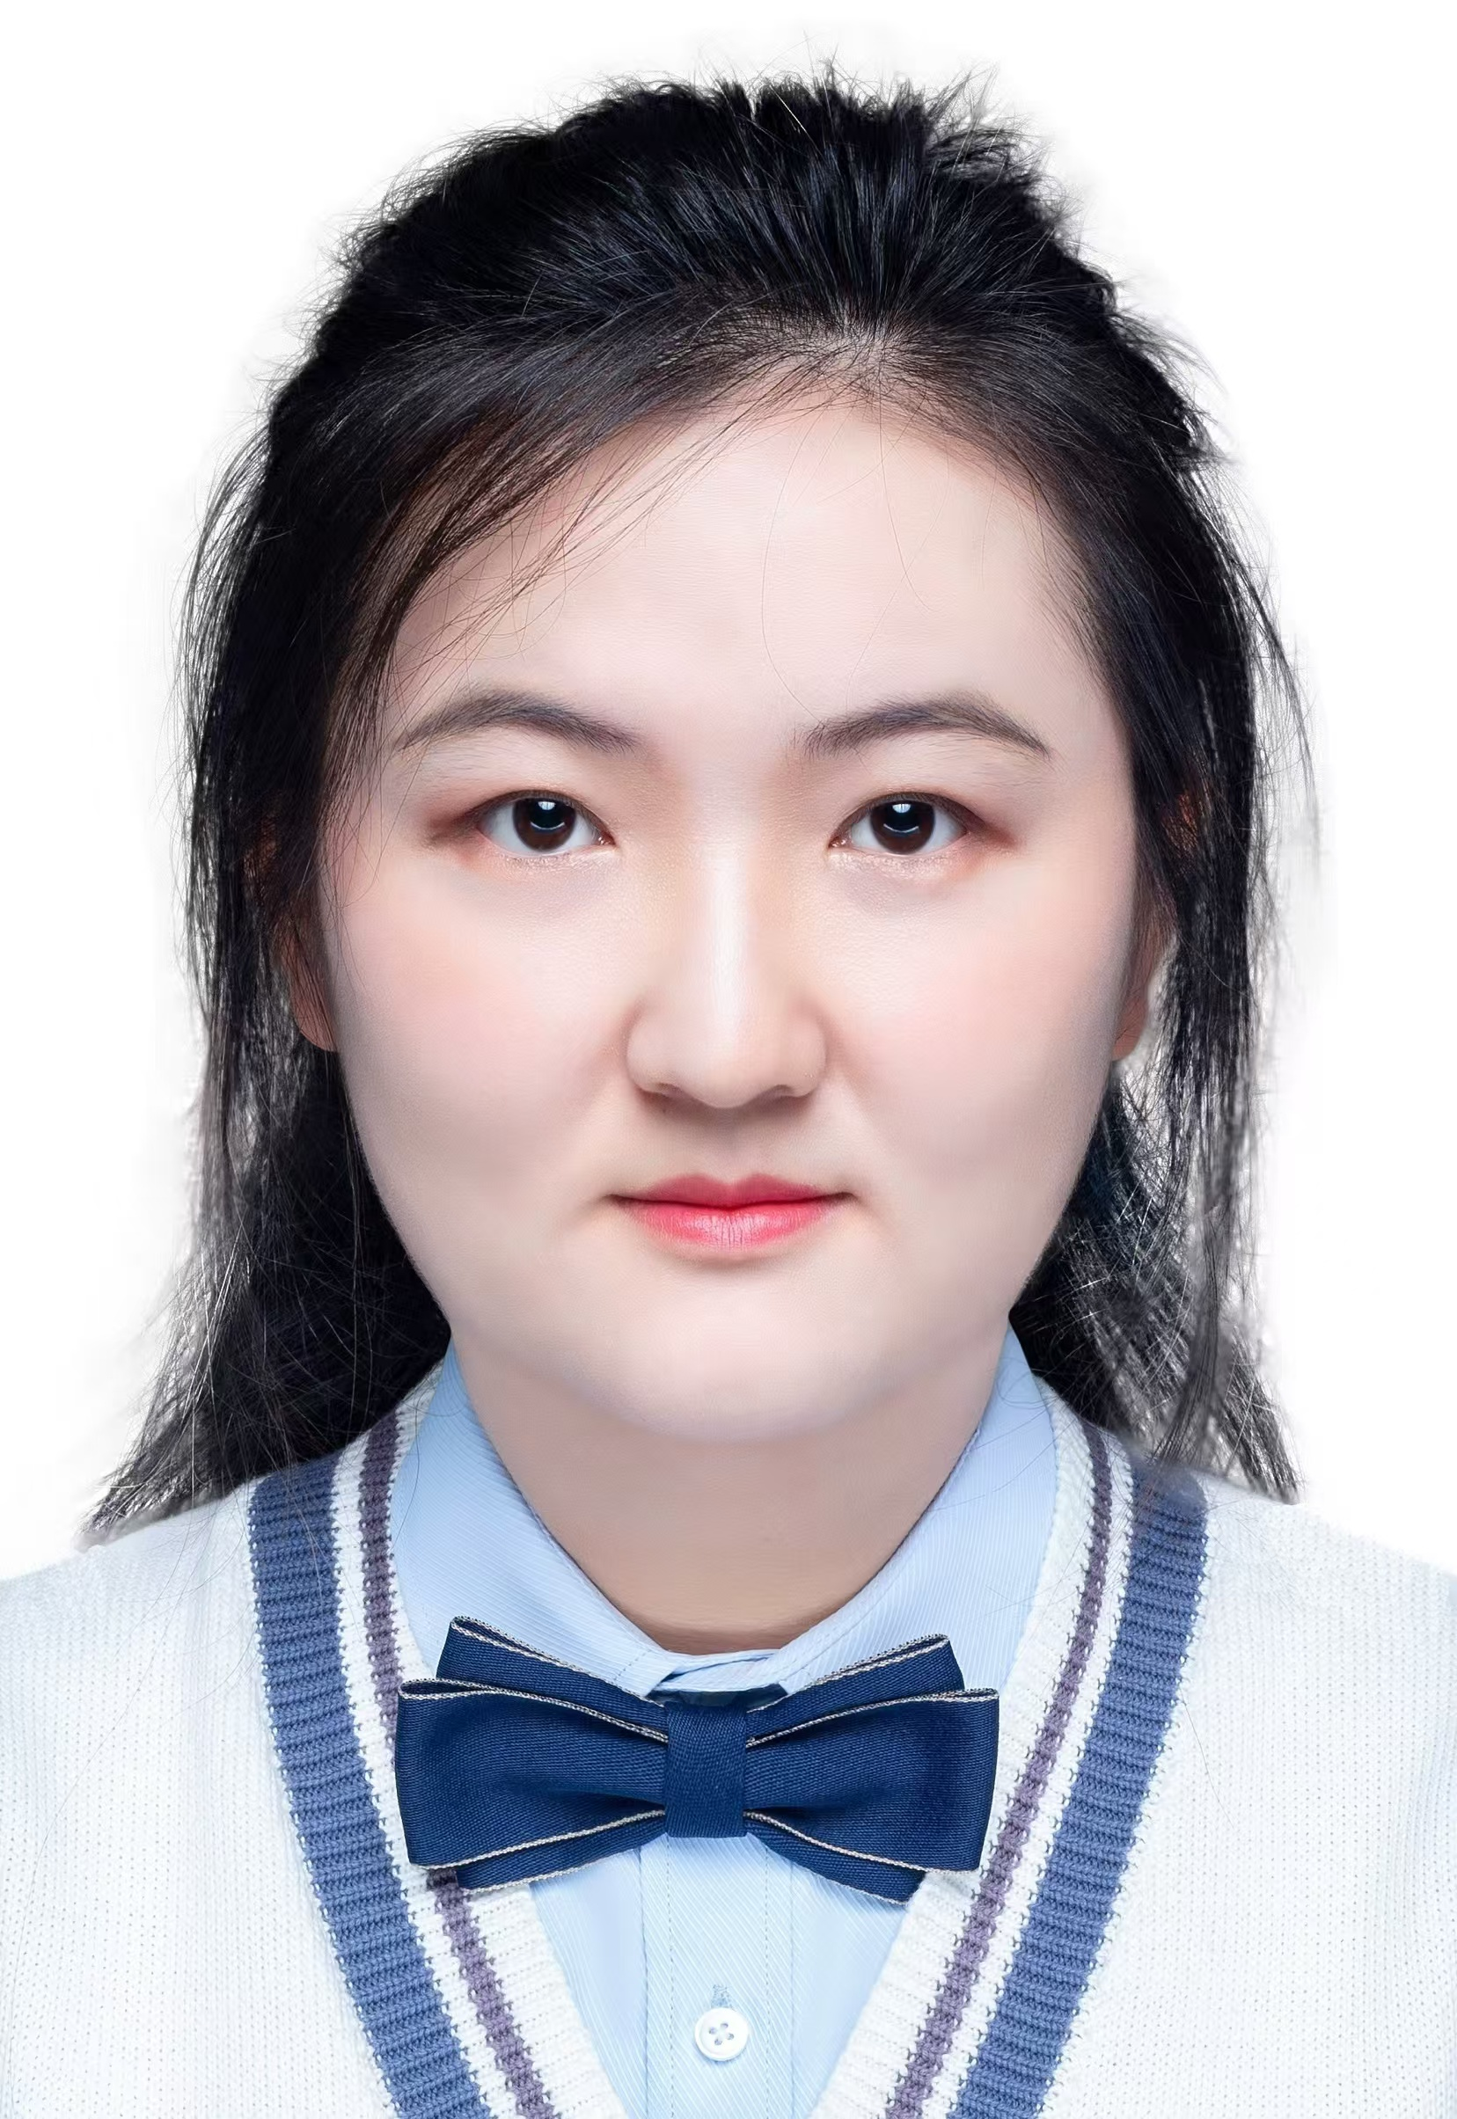

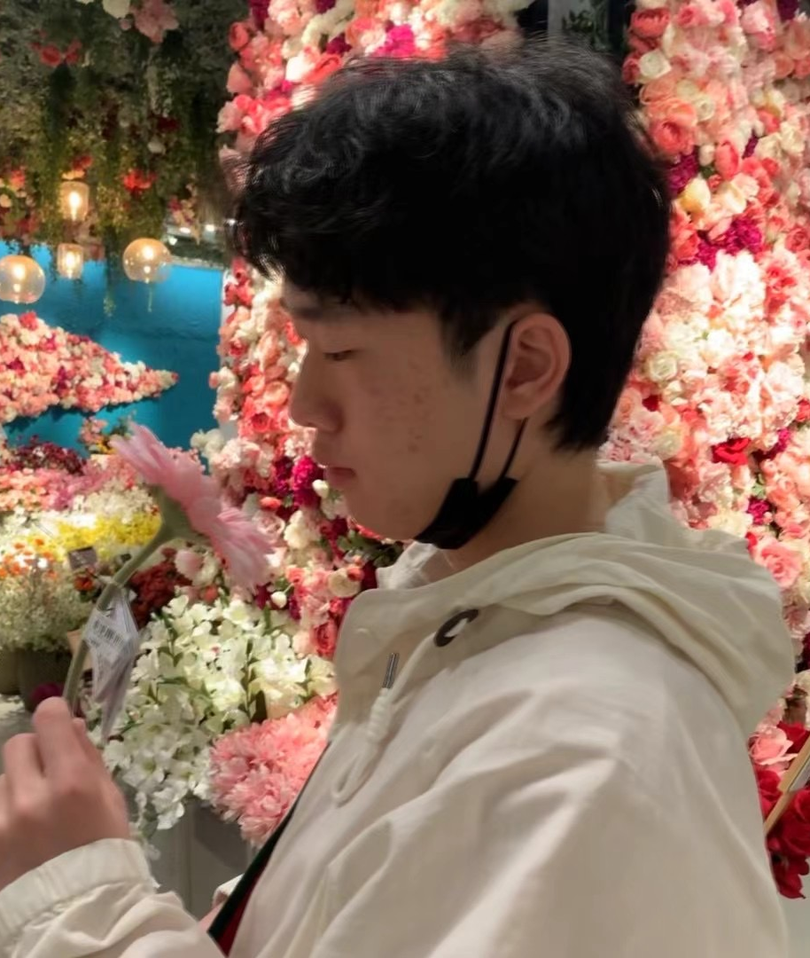

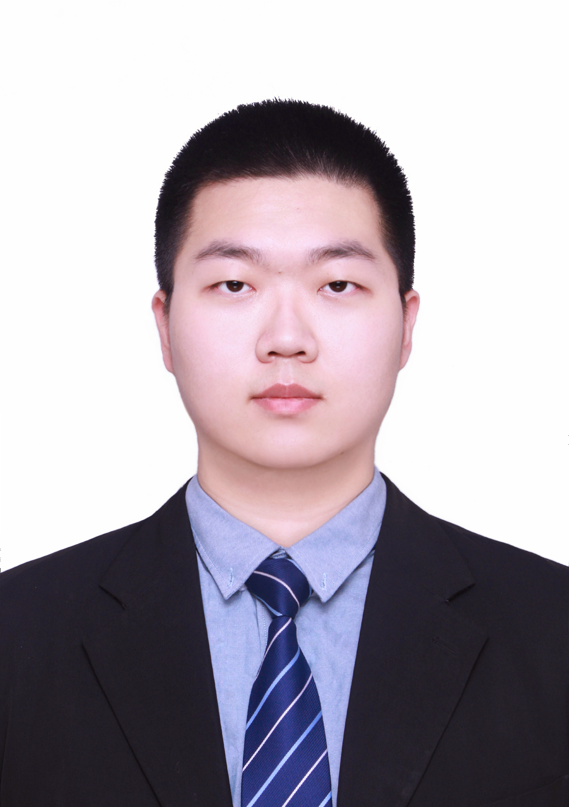
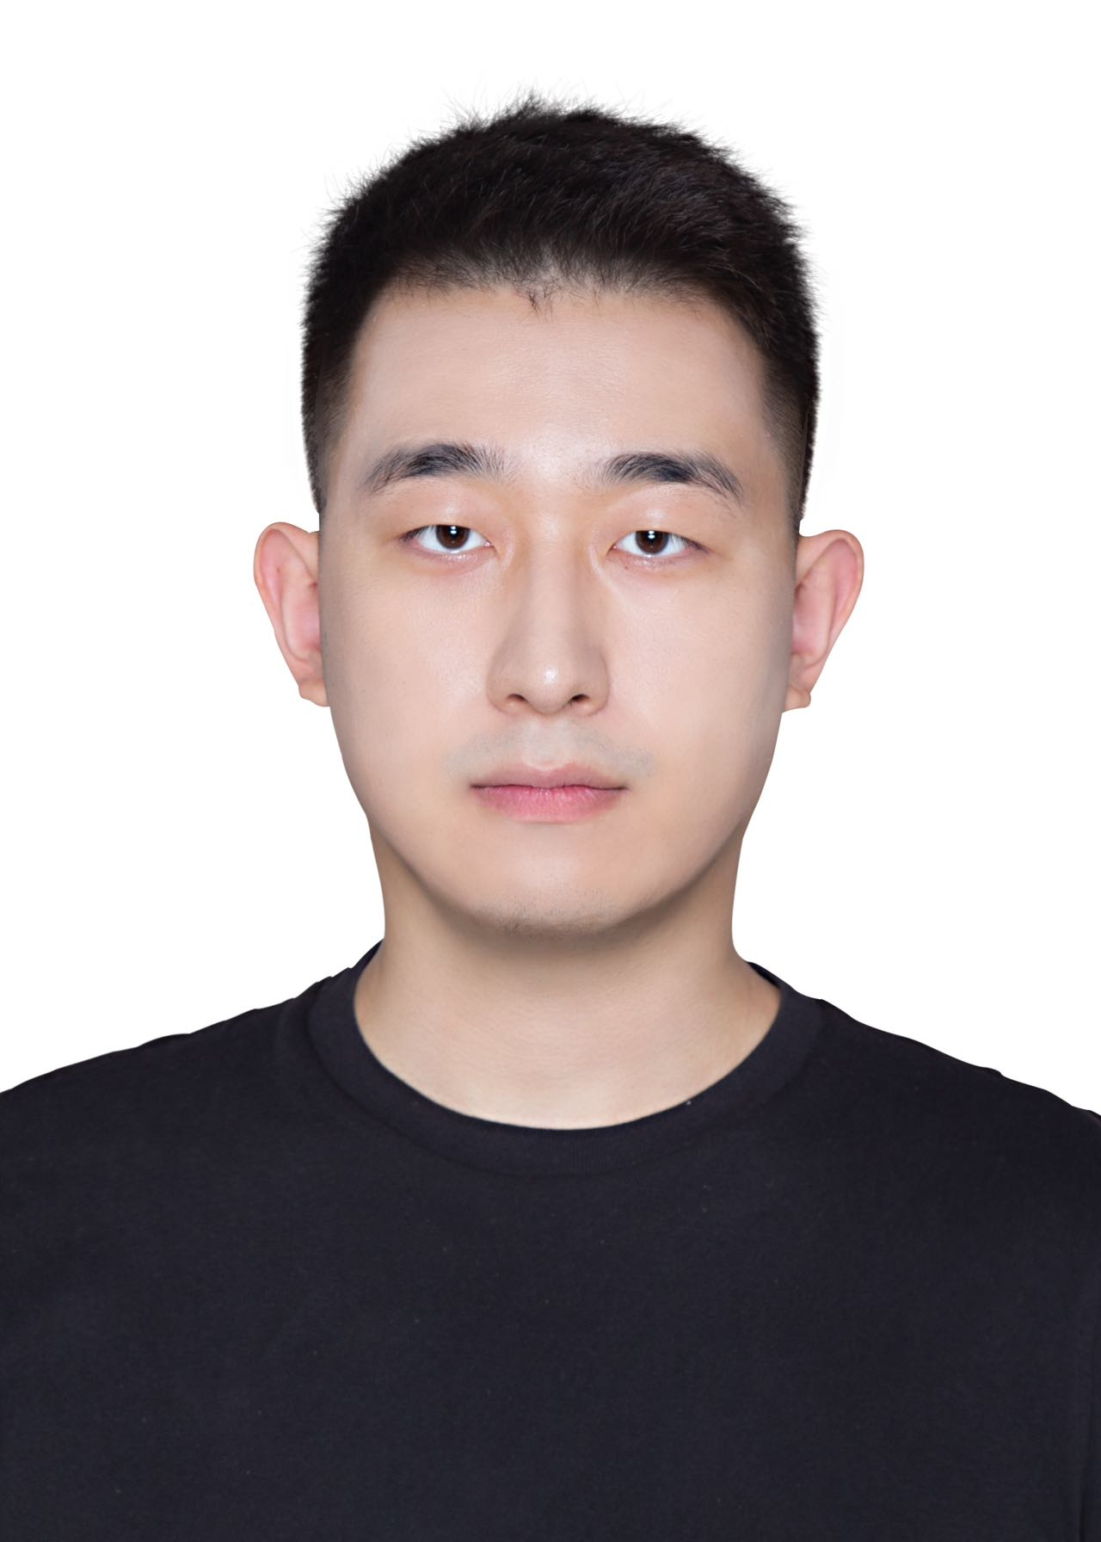

Teaching Assistants
Jingxuan Liu
jingxuan.liu19@student.xjtlu.edu.cn
Bolin Ren
bolin.ren19@student.xjtlu.edu.cn
Ziyu Ye
ziyu.ye19@student.xjtlu.edu.cn
biwen.meng
biwen.meng22@xjtlu.edu.cn
Yuqi He
yuqi.he24@student.xjtlu.edu.cn
Tieming Li
tieming.li24@student.xjtlu.edu.cn
Zimo Wang
zimo.wang24@student.xjtlu.edu.cn

Slide 8
TA Supporting
Lab Section:
Lab Day 1: 1 Teacher + 1 TA
Lab Day 2: 2 TAs
Long Time Supporting
Friday 13:00-18:00
Location: D-3008 Meeting Room

Slide 9
Educational Aims of the Module
This module aims to introduce the essential principles of Natural Language Processing (NLP), covering techniques, algorithms, and applications.
The goal is to provide a solid foundation for understanding how computers can process and understand human language.
Students will delve into both basic concepts and techniques used in NLP, gaining experience of applying NLP models and techniques to solve real-world problems.

Slide 10
Learning Outcomes
A Understand the basic concepts and techniques of Natural Language Processing.
B Apply statistical and machine learning techniques to process and analyse large-scale textual data.
C Implement deep learning models and evaluate them based on performance metrics.
D Develop skills of using NLP models and techniques in real-world applications.

Slide 11
Assessment Details
Coursework must be submitted on-line, and no later than the following date: Coursework 1 :
Group Report: 5 pm China time (UTC+8 Beijing) on Sat. 19th. Oct. 2024
Peer Assessment : 5 pm China time (UTC+8 Beijing) on Sat. 26th. Oct. 2024
Coursework 2 : 5 pm China time (UTC+8 Beijing) on Sat. 2nd. Nov. 2024
Resit Assessment : NO
Sequence | Assessment Type | Method | Learning Outcomes Assessed | Week | % of Final Mark | Resit (Y/N/S)
1 | CW | Group Coursework (Group Assignment) | A, B | 5 | 40 | N
2 | CW | Individual Coursework (Individual Project) | C, D | 7 | 60 | N

Slide 12
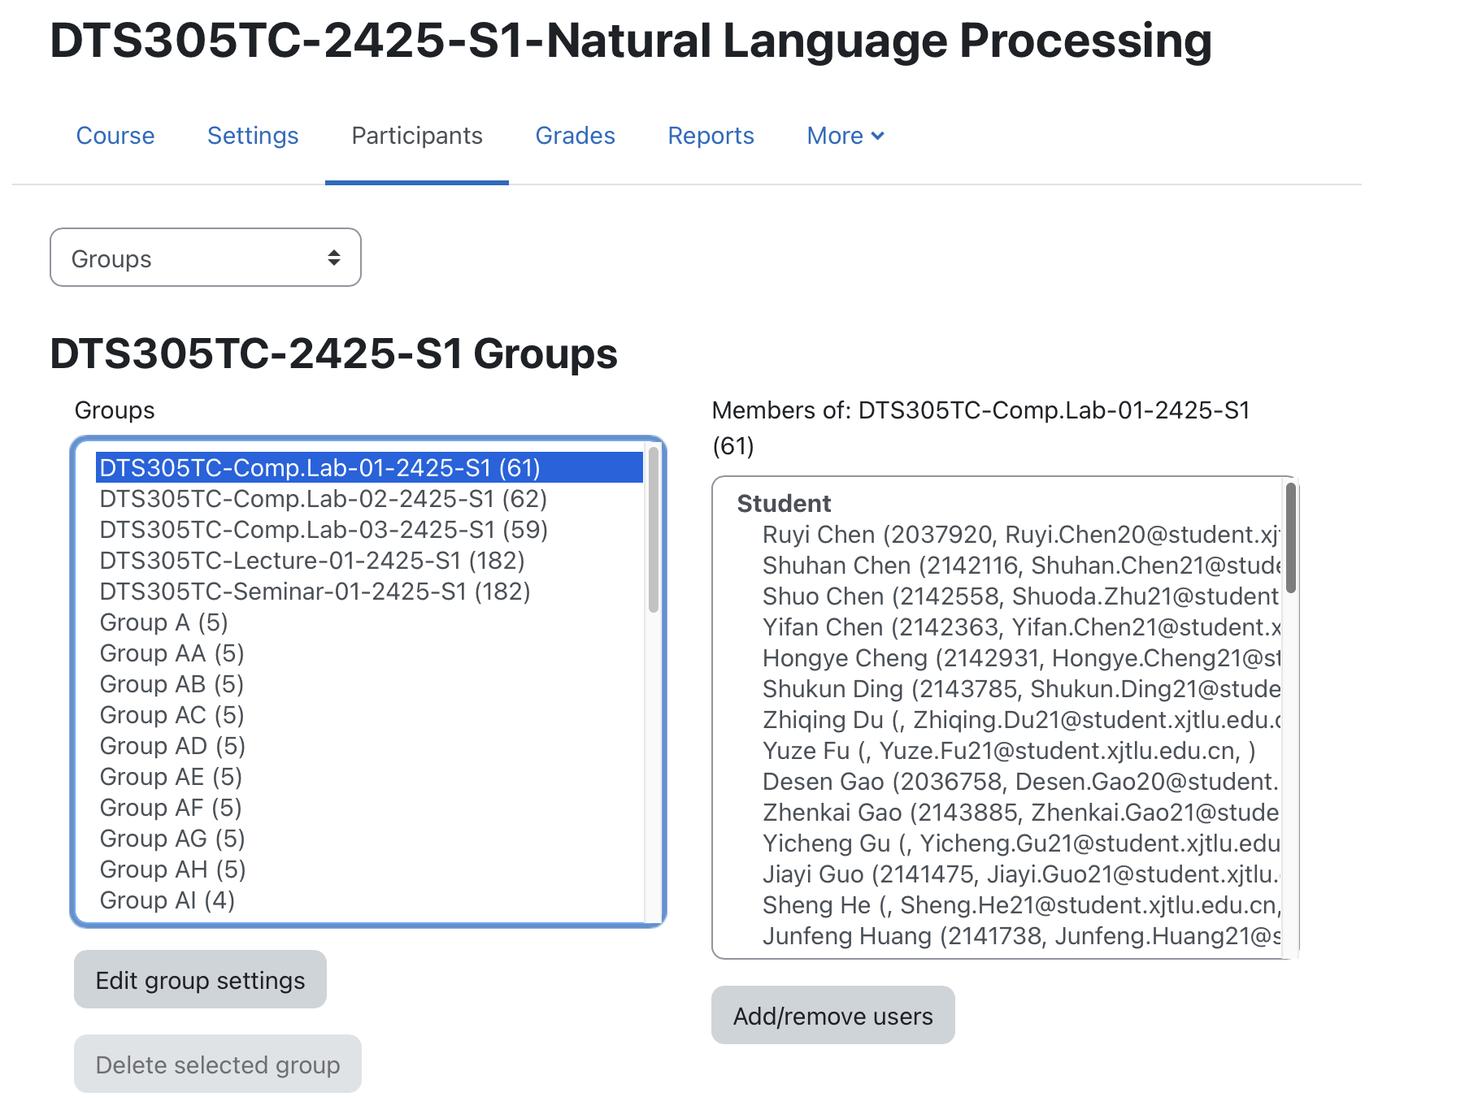
Grouping information

Slide 13
Methods of Learning and Teaching
The teaching philosophy of the module follows very much the philosophy of Syntegrative Education. This has meant that the teaching delivery pattern, which follows more intensive block teaching, allows more meaningful contribution from industry partners. This philosophy is carried through also in terms of assessment, with reduction on the use of exams and increase in coursework, especially problem-based assessments that are project focused. The delivery pattern provides space in the semester for students to concentrate on completing the assessments.
This module will be delivered by a combination of formal lectures, seminars, and computer labs. The lectures cover the content outlined in the syllabus, introducing natural language processing topics. Labs are designed to equip students with essential programming skills in module-related areas. Through hands-on group assignments and individual project, students gain practical experience in implementing and experimenting with natural language processing algorithms and undertaking independent study and research on natural language processing problems.

Slide 14
Syllabus and Teaching Plan
Week Number and/or Date | Lecture/Seminar/Field Trip/Other | Topic/Theme/Title | Lecturer/Instructor | Pre-reading
Week 1/D1Monday10:00-12:00am | Lecture 1TC-FG-2001 | Introduction to Natural Language Processing | Dr. Huakang LI | Chapter 1
Week 1/D2Wednesday10:00-12:00am | Lecture 2TC-FG-2001 | -Textual formats and sources, e.g., social media, APIs, web scraping-Tokenization, stemming and lemmatization. | Dr. Huakang LI | Chapter 2
Week 2/D1Monday10:00-12:00am | Lecture 3TC-FG-2001 | -bag-of-words representation-TF-IDF | Dr. Huakang LI | Chapter 3
Week 2/D2Wednesday10:00-12:00am | Lecture 4TC-FG-2001 | -Text/Document Classification-Text Clustering, Topic Modelling | Dr. Huakang LI | Chapter 4
Week 3/D1Monday10:00-12:00am | Lecture 5TC-FG-2001 | -Information Retrieval-Named Entity Recognition | Dr. Huakang LI | Chapter 5
Week 3/D2Wednesday10:00-12:00am | Lecture 6TC-FG-2001 | -Word embeddings-Recurrent Neural Networks | Dr. Huakang LI | Chapter 6
Week 4/D1Monday10:00-12:00am | Lecture 7TC-FG-2001 | -Convolutional Neural Networks-Transformer, BERT and GPT | Dr. Huakang LI | Chapter 7
Week 4/D2Wednesday10:00-12:00am | Lecture 8TC-FG-2001 | -Sentiment Analysis-Machine Translation | Dr. Huakang LI | Chapter 8
Week 5/D1Monday10:00-12:00am | Lecture 9TC-FG-2001 | -Document SummarizationDomain-Specific NLP | Dr. Huakang LI | Chapter 9
Week 5/D2Wednesday10:00-12:00am | Lecture 9TC-FG-2001 | -NLP summarization-Technology conclusion | Dr. Huakang LI | Chapter 10

Slide 15
Lab schedule & seminar
Labs
Student Group | Time | Day | Venue | Lecturer/Instructor
Group 1 | 13-15pm | Week1-5 / Mondays | TC-D-3001 | Dr. Huakang LI &TA1
Group 1 | 16-18pm | Week 1-5 / Wednesday | TC-D-3001 | Dr. Huakang LI &TA1 &
Group 2 | 15-17pm | Week1-5 / Mondays | TC-D-3001 | Dr. MD MARUF HASAN &TA3
Group 2 | 09-11am | Week 1-5 / Thursday | TC-D-3001 | Dr. MD MARUF HASAN &TA3 &TA4
Group 3 | 16-18pm | Week1-5 / Tuesday | TC-D-3001 | Dr. Qi CHEN Jingxuan Liu
Group 3 | 11-13am | Week 1-5/ Thursday | TC-D-3001 | Dr. Qi CHEN &TA5& TA6
Seminar
Week Number and/or Date | Lecture/Seminar/Field Trip/Other | Topic/Theme/Title | Lecturer/Instructor
Week 6Monday10:00-12:00am | SeminarTC-FG-2001 | CW Seminar | Dr. Huakang LI

Slide 16
optional textbook
Title | Author | ISBN/Publisher
Speech and Language Processing | Daniel Jurafsky | Draft of August 20, 2024
Module learning content reference link
Stanford University
CS124 : From Language to Information
https://web.stanford.edu/class/cs124/

Slide 17



THANK YOU
Visit us
FOLLOW us
www.xjtlu.edu.cn
Notes:
Title: Uppercase, Calibri size 60, XJTLU Navy

